Slide 1
Neural Machine Translation Using Python
Virgilia Antonucci, CSC Postbacc Fellow

Slide 2
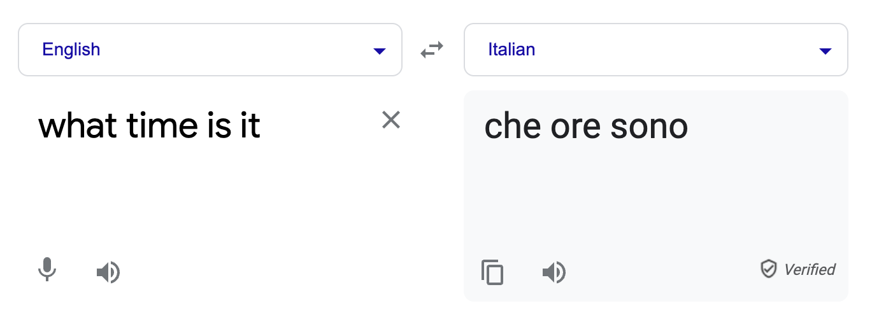
What is Machine Translation?

Slide 3
‘90s-’10s
Statistical Machine Translation (SMT) was a huge research field
Requires large volumes of bilingual data
SMT systems learn to translate by analyzing the relationships between the two languages in the data file

Slide 4
‘90s-’10s
Features designed to capture particular language phenomena
Required compiling and maintaining extra resources
Like tables of equivalent phrases
Lots of human effort to maintain
Repeated effort for each language pair!

Slide 5
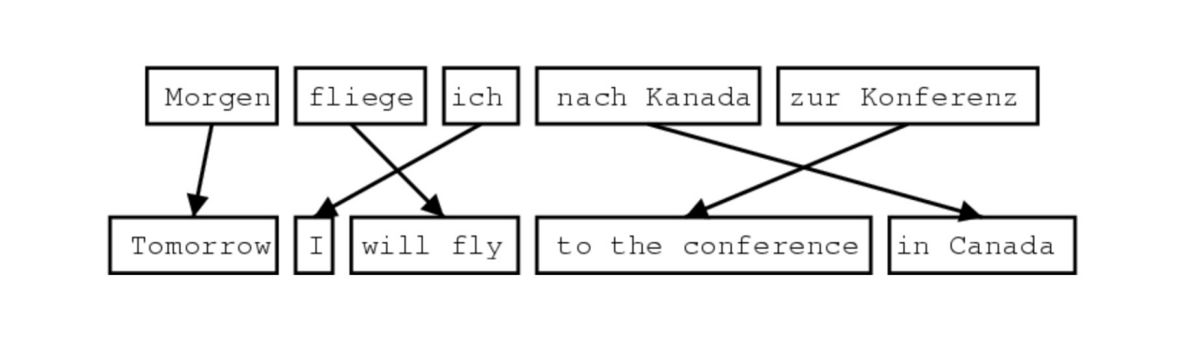
Statistical Machine Translation
The first step is to have parallel data, meaning the same text translated into the input and output language.

Slide 6
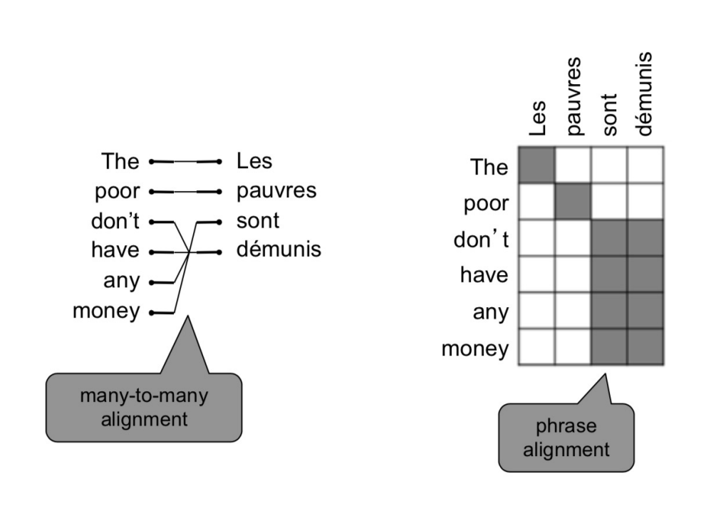
Alignment

Slide 7
Neural Networks
A method in artificial intelligence that teaches computers to process data in a way that is inspired by the human brain
Instead of feeding the NN something like a dictionary, we give it a collection of sentences
It picks up on patterns, which enable it to translate later on
For example, rather than teaching it verb tenses, it will pick up the pattern on how to conjugate by itself

Slide 8
2014: Neural Machine Translation
Neural Machine Translation (NMT) is a way to do Machine Translation with a neural network
One possible neural network architecture is called a sequence-to-sequence model (aka seq2seq) and it involves two recurrent neural networks (RNNs)

Slide 9
Seq2Seq
One neural network takes input and produces a numerical encoding
Another network produces output (decoding) based on the encoding
Since the input and output are sequences, we call it a seq2seq model
The sentences follow a specific word order

Slide 10
Tokenization
Tokenization is the process of splitting up words in a phrase so that we can analyze the words ("tokens") individually
The tokens don't have to be words–they can be anything we wish to split up and analyze individually. For example, we can tokenize the word "Hello" into letters [H,e,l,l,o]”

Slide 11
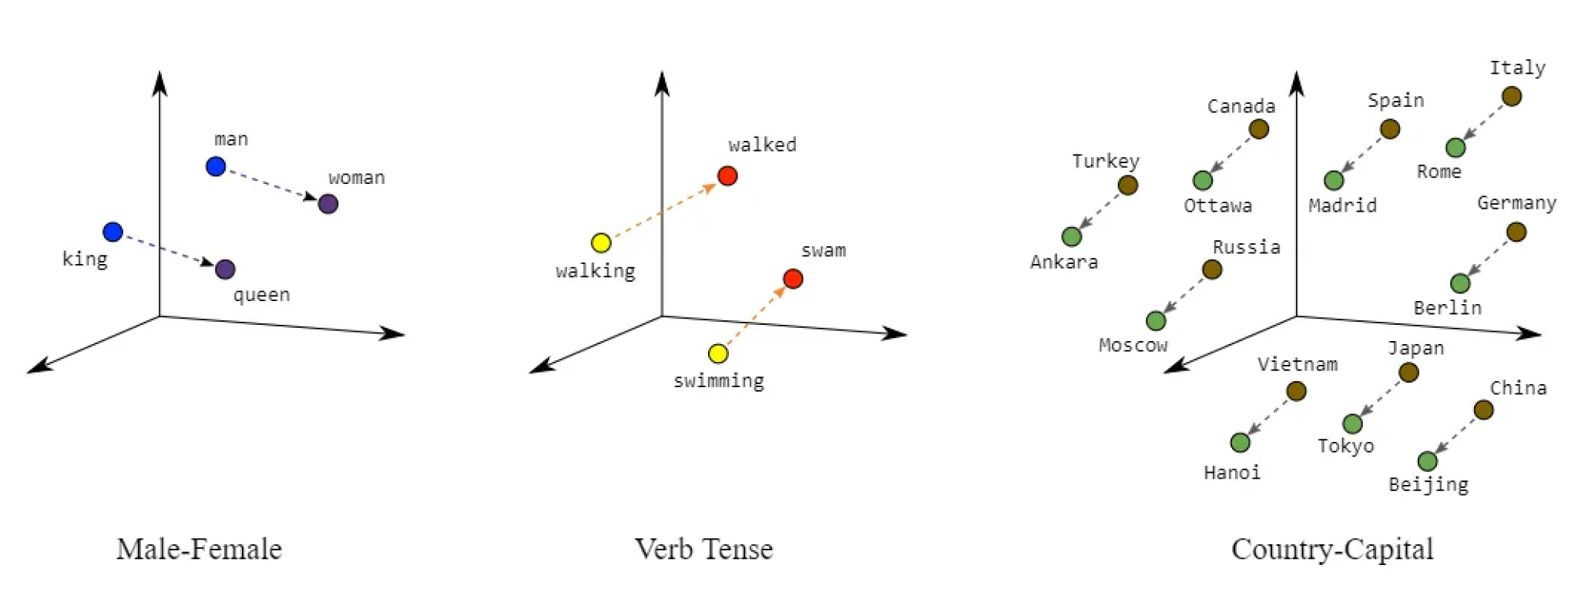
Embedding: You can’t run an algorithm on words, so we need to make them numbers.

Slide 12
Training
We train our NN by providing it with training data: the phrases with their corresponding translations
The NN updates its parameters (weights) to accurately fit our training data
It does this through a concept called "backprop"
Then it tests itself by translating a sample from our data that has a corresponding translation

Slide 13
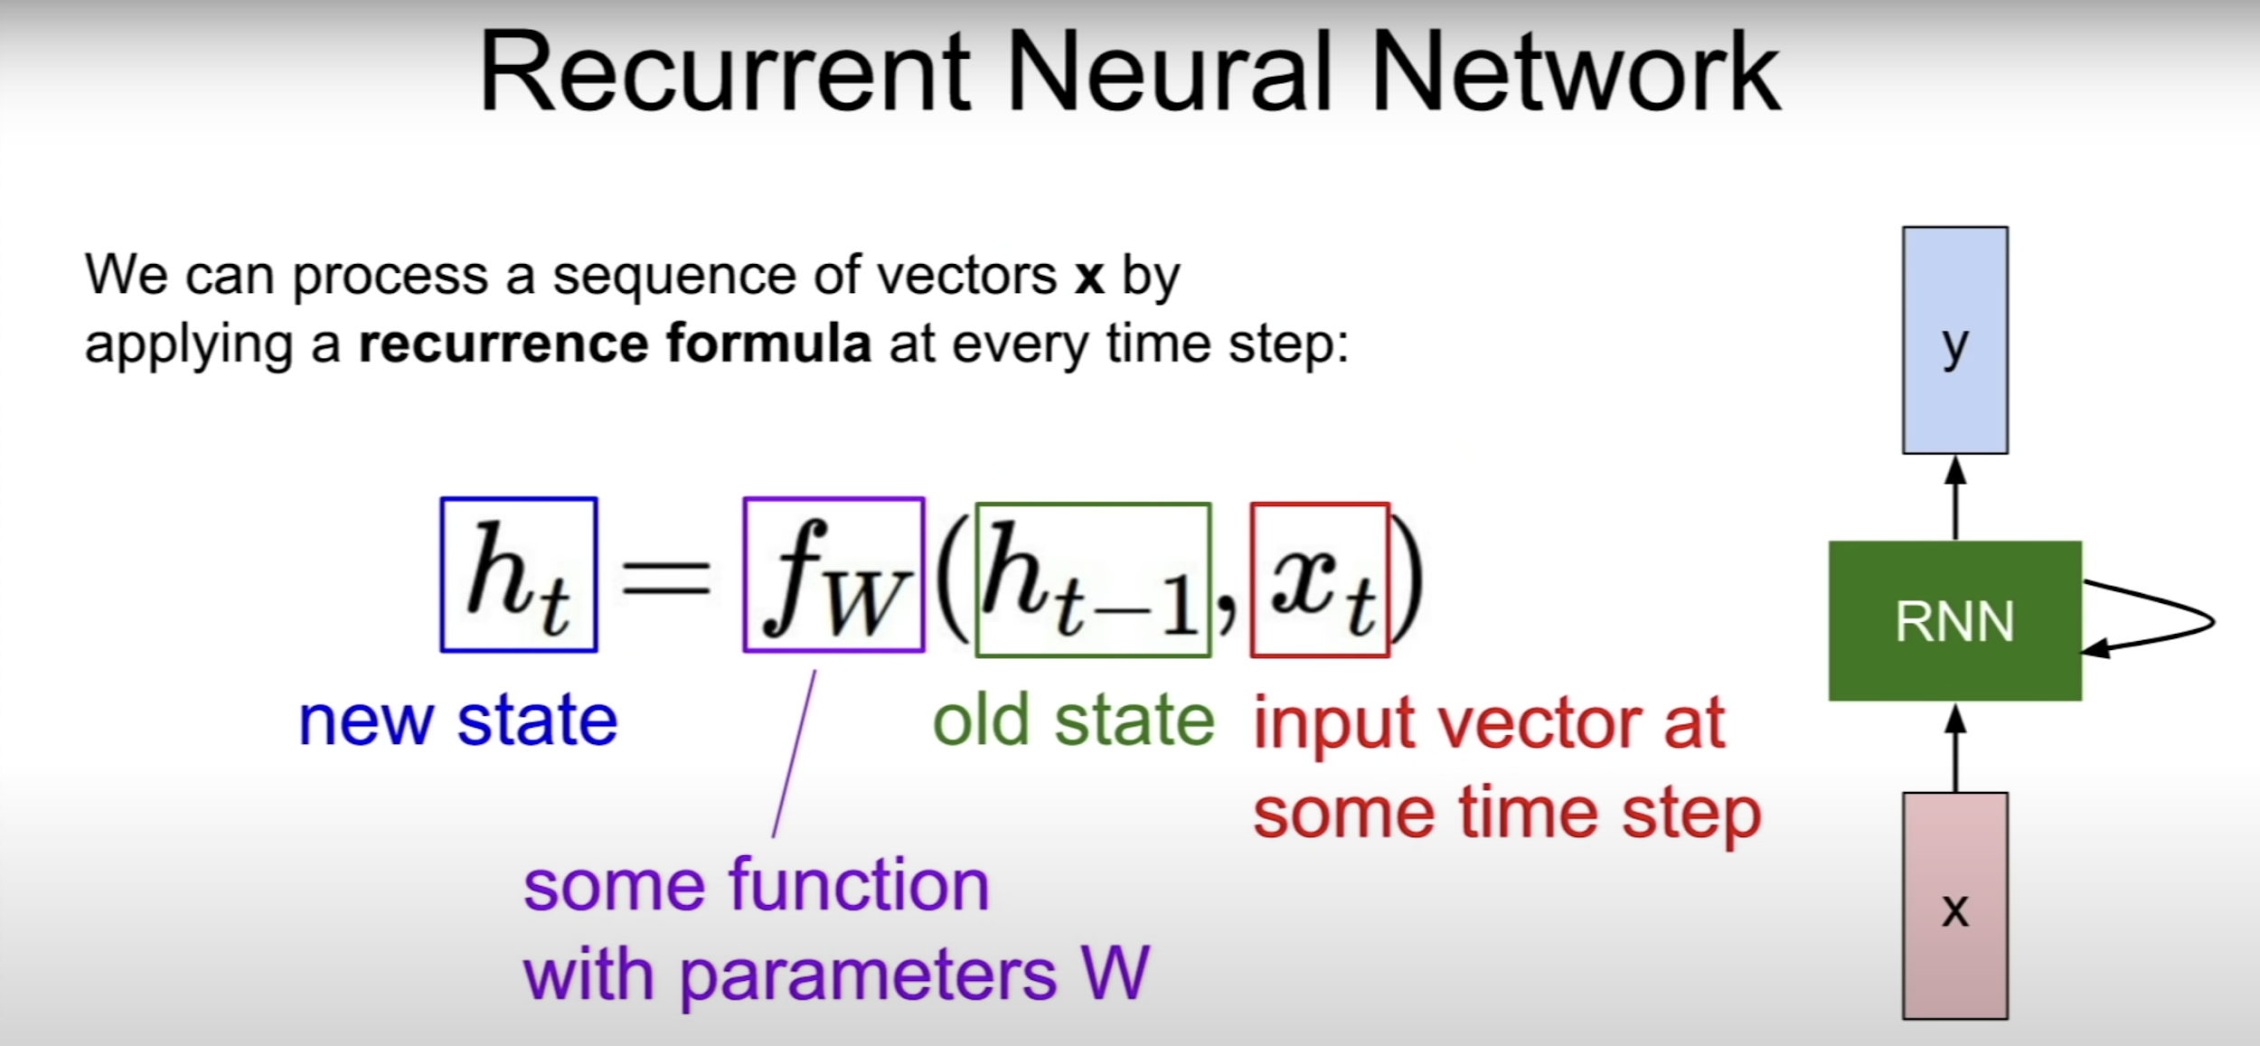

Slide 14
Char2Char
Our code (that we will get to) demonstrates how to implement a basic character-level recurrent sequence-to-sequence model.
We apply it to translating short English sentences into short Italian sentences, character-by-character.

Slide 15
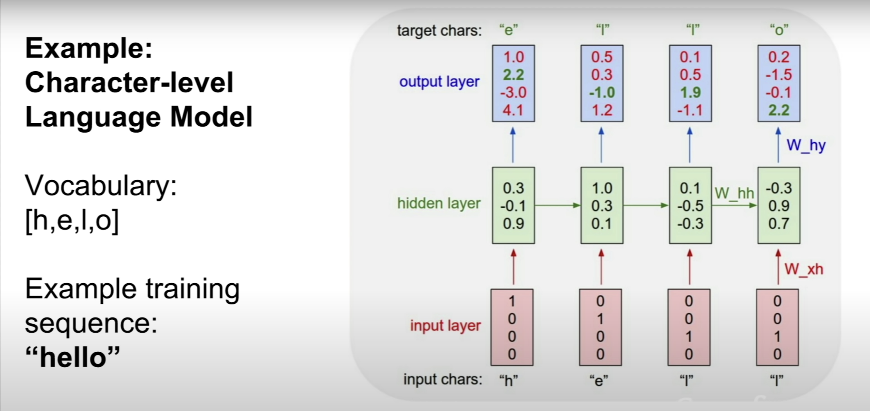

Slide 16
Overview
Getting data
Cleaning it
Preparing It
Create NN
Training
Predictions

Slide 17
Let’s look at the code now!

Slide 18
Char2Char in Other Languages
Relatively straightforward to do Char2Char translation in languages that use the Latin alphabet.
Character-based languages, like Chinese and Japanese, would require a much larger dataset to train using a Char2Char approach.

Slide 19
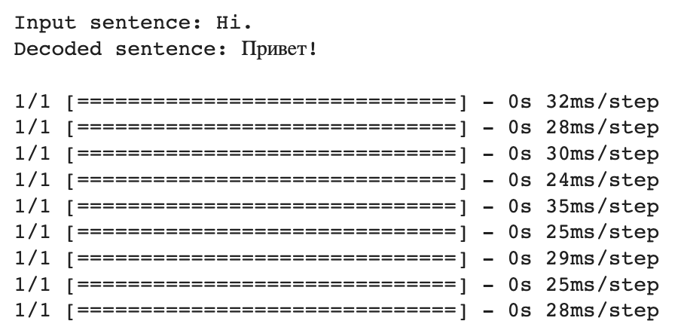
Russian
Consists of 23 letters

Slide 20
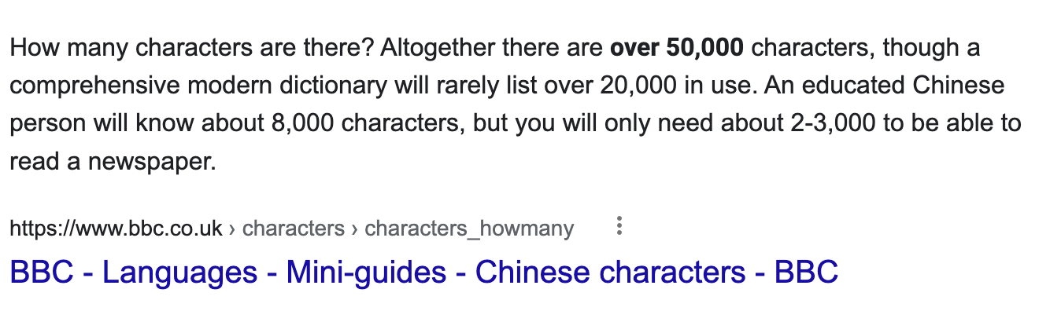

Slide 21
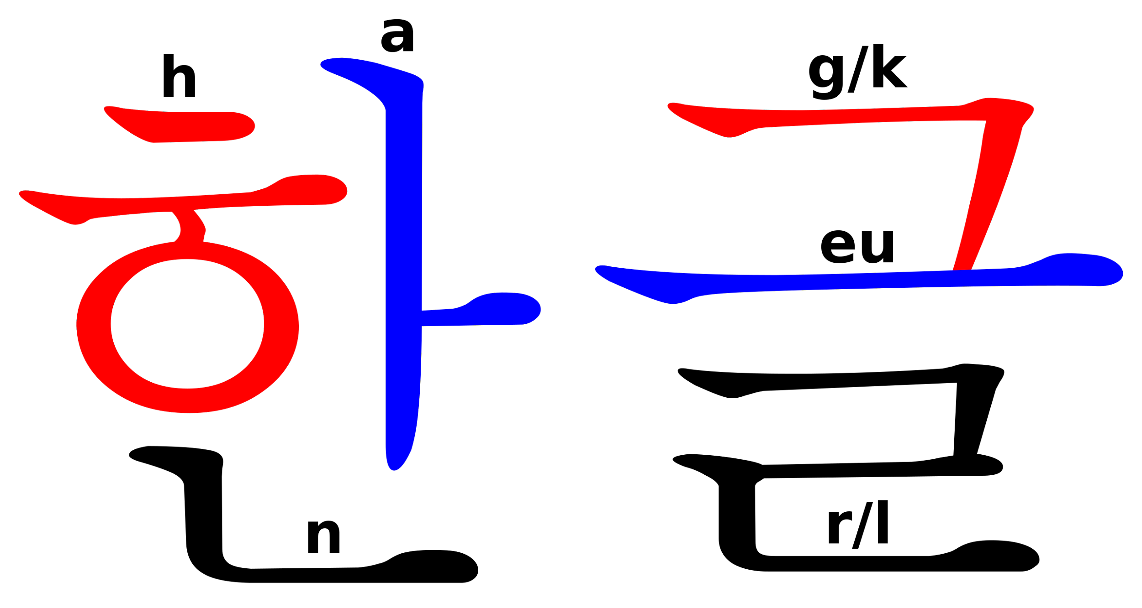
Korean, which uses an alphabetic syllabary, is still difficult to train due to the large number of possible characters.
There are roughly 11,000 possible Hangul syllable blocks, with about 4,000 characters in common use.

Slide 22
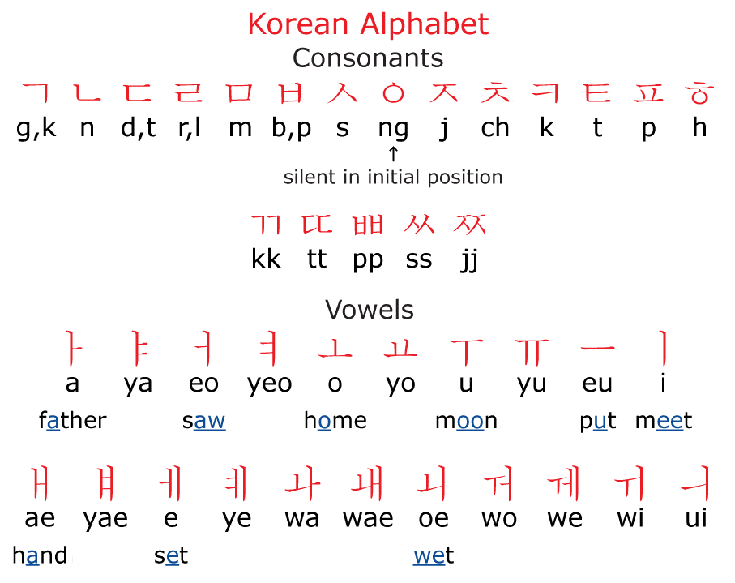

Slide 23
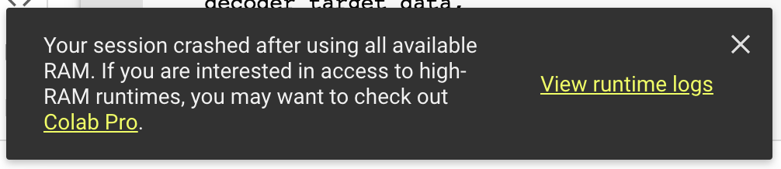
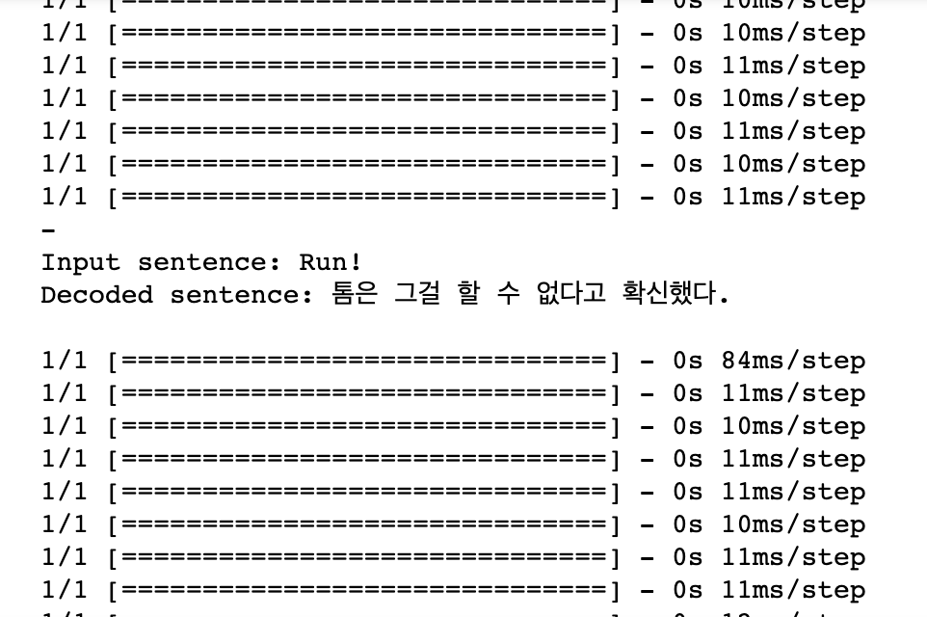
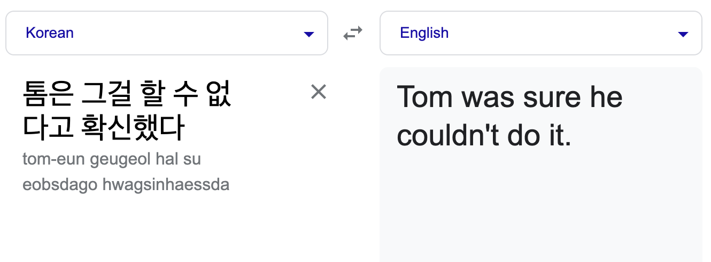
Korean

Slide 24
Thanks!
Email any questions to csc@barnard.edu or vantonuc@barnard.edu.

Slide 25
Resources
Slides
SMT Background
Stanford NLP
Word Embeddings Background
RNNs
Keras
Char2Char Translation

